Slide 1
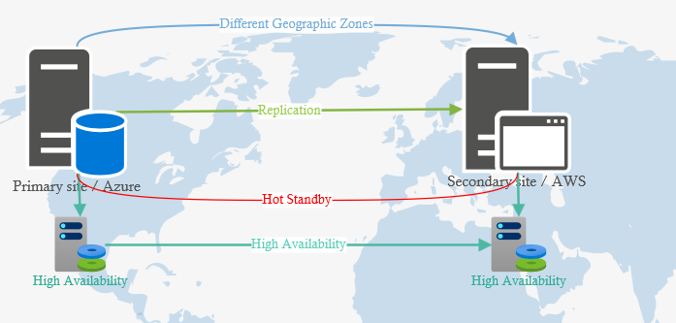
High Availability (HA): This diagram illustrates a primary active data centre and a hot standby data centre located in different geographic zones to ensure resilience against local disasters (such as natural disasters or power outages).
Real-time Data Replication: The data from the primary site is continuously replicated to the hot standby site. This ensures that the data is never more than 1 hour behind the primary site in case of failure.
Automatic Failover: The system has an automatic failover mechanism that transfers operations from the primary site to the hot standby site with minimal downtime. This ensures the business can resume operations within an 8-hour (RTO) without manual intervention.
Key takeaway: The hot standby site is always up-to-date and can immediately take over operations if the primary data centre fails.

Slide 2
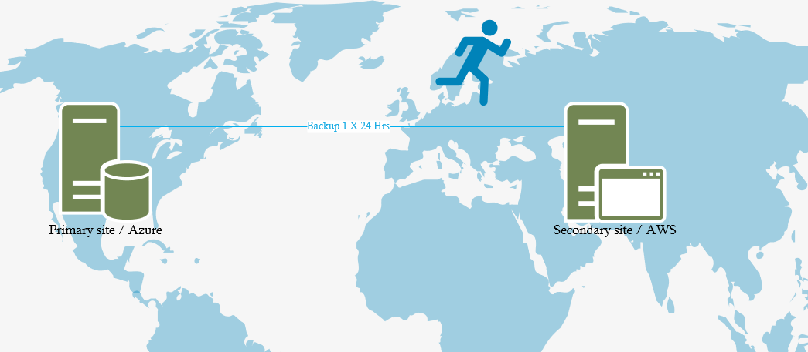
Cold Standby Site: This diagram shows a primary active and cold standby data centre; unlike the previous setup, the cold standby site is not continuously updated and remains inactive until needed.
Periodic Backups: Data is backed up to the standby site periodically (e.g., once every 24 hours), meaning that in a disaster, data loss could be up to 24 hours (RPO).
Manual Failover: Since high availability is not required, there is no automatic failover. The recovery process requires manual intervention, which extends the RTO to 72 hours.
Key takeaway: This is a cost-effective solution for non-critical workloads where long downtime and potential data loss of up to 24 hours are acceptable. This design choice should instill confidence in the system's ability to handle such scenarios.
Notes:
By using separate vendors, we avoid vendor lockin. Using 2 different suppliers allows for redundancy, selecting Geo-redundant storage also allows redundancy on the storage front.

Slide 3
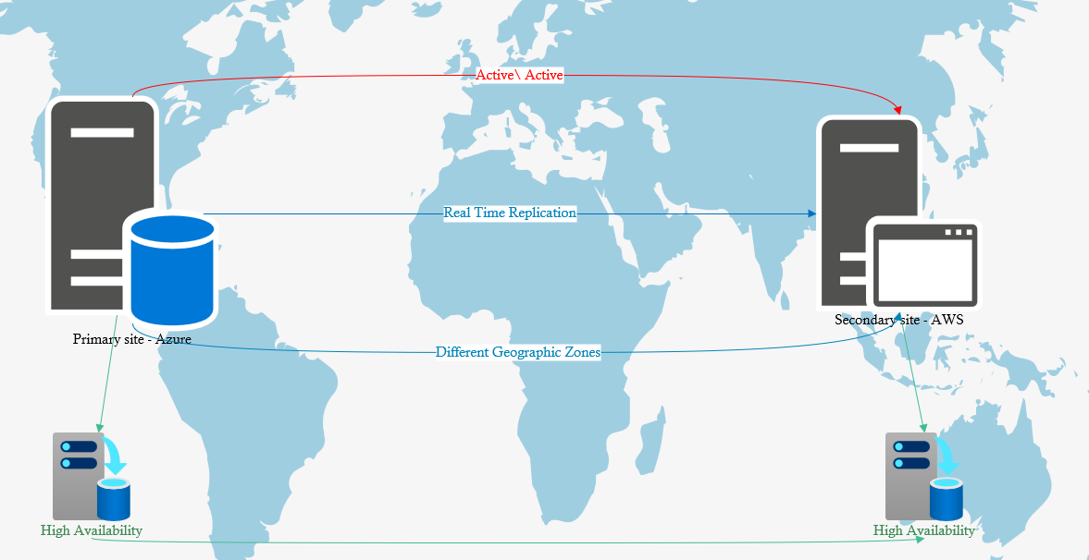
Active-Active Data Centers: The diagram shows two active data centres located in different zones. Both centres are operational at the same time (active-active configuration).
Real-time Data Synchronisation: Data is continuously synchronised in real-time between the two sites, ensuring that data at both locations is no more than 5 minutes old (RPO). This allows immediate failover in the event of an outage.
Automatic Failover: In the event of a failure at one of the data centres, the other centre automatically takes over, ensuring that services can be restored within 1 hour (RTO).
Key takeaway: This setup provides the highest level of availability and minimal downtime, designed for critical applications where even a few minutes of data loss or downtime can be costly.

